Slide 1
OUTLINE
WHAT ARE EVOLUTIONARY ALGORITHMS
HOW CLASSICAL GENETIC ALGORITHMS WORK
FROM GA TO DIFFERENTIAL EVOLUTION
PARTICLE SWARM OPTIMIZATION

Slide 2
Darwin’s core statement in his own language (1859)
“As many more individuals are produced than can possibly survive, there must in every case be a struggle for existence, either one individual with another of the same species, or with the individuals of distinct species, or with the physical conditions of life… . Can it, then, be thought improbable, seeing that variations useful to man have undoubtedly occurred, that other variations, useful in some way to each being in the great and complex battle of life, should sometimes occur in the course of thousands of generations? If such do occur, can we doubt (remembering that many more individuals are born than can possibly survive) that individuals having any advantage, however slight, over others, would have the best chance of surviving and of procreating their kind? On the other hand, we may feel sure that any variation in the least degree injurious would be rigidly destroyed. This preservation of favorable variations and the rejection of injurious variations, I call Natural Selection.”

Slide 3
FROM GENETIC ALGORITHMS TO DIFFERENTIAL EVOLUTION
WHAT ARE EVOLUTIONARY ALGORITHMS?
Application of the principle of Natural Selection – The Survival of the Fittest – to the problem of Optimization.
HOW?

Slide 4
Darwin was unaware of Genetics
Darwin was unaware of the existence of genes, chromosomes or DNA
However, he with his team was aware that parents somehow pass on their physical characteristics to children
Gregory Mendel, Austrian monk (1866), postulated the theory that small elements in the cells of parents codify these physical characteristics and pass them on to children as pairs – one from each parent
His theory became popular only after 1900 when scientists actively starting researching into and developing this field
Now Gregor Mendel is known as the father of Genetics.

Slide 5
From Natural Selection of Species – through Natural Selection of Chromosomes – to Natural Selection of Optimal Solutions
It was not until the 1960’s that people started thinking –
Can not the genetic techniques that enable the natural evolution of biological species …..
….. be applied to the natural evolution of optimal solutions ….
if these artificial optimal solutions can somehow be expressed as chromosomes and genes?
In the late 1960’s and early 70’s , Ingo Rechenberg in Germany and John Holland in USA independently came up with methods for the artificial evolution of optimization problems
Rechenberg came up with Evolutionary Strategies and Holland with Genetic Algorithms
Other techniques were also invented that broadly come under the umbrella of Evolutionary Algorithms.

Slide 6
Biologically Inspired Algorithms
There is an important class of Algorithms in Artificial Intelligence that are known as Biologically Inspired Algorithms
They Include:
Evolutionary Algorithms
Swarm Algorithms (also known as Socially Inspired Algorithms)
Fuzzy Logic
Artificial Neural Networks
They comprise an important subset of AI called Computational Intelligence and also Soft Computing.

Slide 7
FROM GENETIC ALGORITHMS TO DIFFERENTIAL EVOLUTION
In the N- dimensional (assuming N- parameters) solution space there exists one point that is the optimum – the global optimum
At this point the objective function which we seek to optimize reaches a global maximum or minimum value
Every single point in this space is associated with a “fitness”, i.e. where it stands relative to this global optimum; there is a one-to-one mapping between the location of each point and its fitness
A number of candidate solutions – the “population” – are created that concurrently traverse the total solution space across “generations” – striving to “evolve” to higher and higher levels of fitness
When a candidate moves from one point to another (evolves), what essentially changes is its state, i.e. the values of its component variables – very often coded as bits called the genes that compose the chromosome
When moving from one generation to the next, the fitter solutions are reproduced more, while the weaker ones are gradually eliminated

Slide 8
FROM GENETIC ALGORITHMS TO DIFFERENTIAL EVOLUTION
CLASSICAL GENETIC ALGORITHMS
SELECTION: More the fitness, more the probability of being
reproduced into the next generation
CROSSOVER: A pair of candidate solutions flip their genes within
a crossover zone
A
A
A
A
A
A
A
A
A
A
A
A
A
A
A
CROSSOVER POINT
B
B
B
B
B
B
B
B
B
B
B
B
B
B
B
AFTER CROSSOVER:
A
A
A
A
A
A
A
A
B
B
B
B
B
B
B
CROSSOVER POINT
B
B
B
B
B
B
B
B
A
A
A
A
A
A
A

Slide 9
FROM GENETIC ALGORITHMS TO DIFFERENTIAL EVOLUTION
CLASSICAL GENETIC ALGORITHMS
Note that Stochastics (Randomness) plays a crucial role in ALL Evolutionary Algorithms.
Thus which pairs are crossed over are selected randomly
Importantly, there is a probability of crossover (say 0.7), and this is effected by generating a random number for each (randomly selected) pair and checking if that number is within the CP
the point of crossover in the chromosome is also selected randomly.

Slide 10
FROM GENETIC ALGORITHMS TO DIFFERENTIAL EVOLUTION
CLASSICAL GENETIC ALGORITHMS
MUTATION: An “Arbitrary” bit in an “Arbitrarily” selected
Chromosome is flipped – role of stochastics and probability of mutation
SELECTION: More the fitness, more the probability of being
reproduced into the next generation. Roulette wheel selection and the role of stochastics.
ELITISM: In a new generation, after crossover & mutation, if the
fitness of the best solution has deteriorated from the
best fitness of previous generation, then the worst
solution of current generation is replaced by that best
solution (of previous gen.)

Slide 11
CROSSOVER – MATHEMATICAL EXPRESSION
Formally, if the dimensionality of the solution space is denoted as D and the number of candidate solutions is N, then the elements of the i^{th} solution vector X­_{i,G} at generation G may be denoted as
Upon crossover between two candidates i and k, an element , i.e. element j of the new candidate i is given as
where CrP denotes random
Crossover point; 1 < CrP < D
while an element , i.e. element j of the new candidate k is given as

Slide 12
FROM GENETIC ALGORITHMS TO DIFFERENTIAL EVOLUTION
Evolutionary Algorithms have two advantages over gradient-based methods:
They are unlikely to get stuck in local optima
They can be applied to problems that are not analytic, and even those that are not mathematically tractable – as long as you can measure the fitness of a candidate
They differ from one another essentially in the mechanism by which a candidate solution evolves from one state (i.e. one point in the solution space) to the next

Slide 13
FROM GENETIC ALGORITHMS TO DIFFERENTIAL EVOLUTION
CLASSICAL GENETIC ALGORITHMS
A SHORTCOMING: The GA brings the solution within a close
neighborhood of the global optimum, and then,
instead of moving straight towards that point , it
tends to “beat around the bush”
ACCELERATION SCHEMES: Various techniques have been developed to
accelerate the solution in this neighborhood zone,
and one class of these techniques plays with the
mutation
ALTERNATE APPROACHES: Keeping in mind the pros and cons of
classical GA, alternate approaches founded
on the evolutionary principle have been
developed. One such approach is
Differential Evolution

Slide 14
FROM GENETIC ALGORITHMS TO DIFFERENTIAL EVOLUTION
DIFFERENTIAL EVOLUTION RAINER STORN, 1995, Univ. of Calif, Berkeley
STEP 1: CREATE A NEW SOLUTION CALLED MUTANT VECTOR AS
where i, r1, r2, r3 are all different, randomly selected
members of the chromosome pool (i.e. population) in
generation “g”,
K and F are relaxation parameters
- in effect a mutant vector is being created for member “i” by
superposing on the old solution suitably scaled differences between
randomly selected alternate members of the population

Slide 15
FROM GENETIC ALGORITHMS TO DIFFERENTIAL EVOLUTION
DIFFERENTIAL EVOLUTION: CROSSOVER
STEP 2: Use the Mutant Vector as a crossover partner for the old
solution to generate the new solution; i.e. some randomly
selected variables composing the old solution are replaced by
corresponding variables from the mutant vector to create the
new solution – called the TRIAL VECTOR
Crossover is performed between the ‘mutant’ vector V_{i,G} and the existing (parent) vector X­_{i,G} to generate a ‘trial’ vector Z_{i,G} according to
where z_{j,i,G} is the element j of the trial vector Z_{i,G}, rand_{j}(0, 1) denotes a random number between 0 & 1 applied to the element j, Cr is the crossover threshold (probability).

Slide 16
FROM GENETIC ALGORITHMS TO DIFFERENTIAL EVOLUTION
DIFFERENTIAL EVOLUTION: ELITISM
STEP 3: Check if the new solution member “i” has higher fitness than
the previous one; if yes, only then replace:
this is Elitism (vertical).
Question related to Step 3: Where is the difference with GA and what are the possible implications?
IT IS SEEN THAT DE’s GENERALLY LEAD TO FASTER CONVERGENCE
THAN CLASSICAL GA’s – SEE ILLUSTRATION IN NEXT SLIDE.

Slide 17
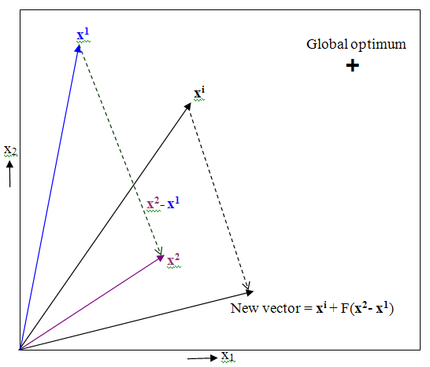
FROM GENETIC ALGORITHMS TO DIFFERENTIAL EVOLUTION
DIFFERENTIAL EVOLUTION RAINER STORN, second-half-90’S
Close after Start

Slide 18
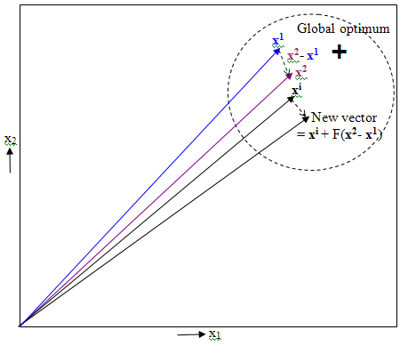
FROM GENETIC ALGORITHMS TO DIFFERENTIAL EVOLUTION
DIFFERENTIAL EVOLUTION RAINER STORN, second-half-90’S
Close to convergence

Slide 19
Implementation of DE Solution
Initial Population
START
For a Generation g
Evaluate Cost
For a candidate in Population p
Selection using Elitism
g = g+1
Generate mutant vector
Traversed all candidates ?
No
Generate Trial Vector
Yes
P = p+1
Solution converged ?
Evaluate Constraints
No
Yes
Constraints satisfied ?
No
Identify best member in pool
Yes
END

Slide 20
Algorithm for Design and Implementation of a DE Solution
Step 0: Get the Inputs: the number of design variables for your system, the range of each variable, the objective function, the constraints
Step 0A: Normalize the input variables only if the nature of the objective function does not get altered by the normalization
Step 1: Decide on the meta-parameters: population size, crossover probability, value of two mutation parameters K and F, max. number of generations
Step 2: Initialize all candidates of the population. Simplest approach: take all random. Better approach: ensure that they are spread over the entire solution space
Step 2A: Confirm that all constraints are satisfied by each initialized candidate, if not, regenerate each till constraints are satisfied

Slide 21
Algorithm for Design and Implementation of a DE Solution
Step 3: Go over each generation
Step 4: Go over each member of population (i.e. candidate)
Step 5: Randomly select the candidates to mutate with this candidate
Step 6: Perform mutation to generate the Mutant Vector
Step 7: Perform crossover to generate the Trial Vector
Step 8: Check the Trial Vector for satisfaction of all constraints, if it fails, repeat steps 5-7 till it passes constraint checks
Step 9: Compare fitness of Trial Vector with Parent Vector and select the fitter one to get into the next generation
Step 10: End population loop
Step 11: Check if solution converged (your convergence criteria?) or max. no. of generations reached, in either case, End Evolution.

Slide 22
Particle Swarm Optimization

Slide 23
Particle Swarm Optimization
Particle Swarm Optimization (PSO) is the foremost among the Swarm Optimization Algorithms, which can be called Cousins of Evolutionary Optimization Algorithms
The similarity is that both work upon a population of candidate solutions that improve in parallel across a large sequence of iterative steps
Dissimilarity: while Evolutionary Algorithms create new solutions from old ones by combining them through crossover- and mutation- like (Genetic Evolution) operations, in Swarm Algorithms the candidates maintain their individual identities and travel over the parameter space by exchanging information with each other (like Swarms)(no “Selection” step)
Strictly speaking, Swarm Algorithms can be more appropriately said to be Socially Inspired rather than Biologically Inspired.

Slide 24
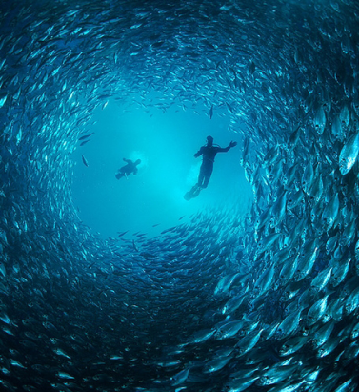

Particle Swarm Optimization

Slide 25
Particle Swarm Optimization
Let us take N candidates of a population in a multi-dimensional (M) solution space, we will call these candidates as “particles”
At any iteration G – strictly we no longer call them generations but instead iterations, however, for similarity with earlier formalisms we still call it G – we have these N particles at various positions p_{i} and moving with corresponding velocities v_{i}, for i ∈ {1, 2, …, N}
Importantly, each particle retains memory of its own best ever position p_{i,best} – where best-ever implies that position which had the best fitness when mapped into objective space – and has information also of the g_{best}, i.e. the global best ever attained by any particle

Slide 26
Particle Swarm Optimization
Then the velocity and position update rules of particle i, in the classical PSO Algorithm, is
and
where, apart from the earlier defined notations,
c₁, c₂ are the weights of local and global information
rand is a random number in [0, 1], different for each use
it is being assumed that velocity represents the change in position from one iteration to the next
c₁ and c₂ are empirical parameters (meta-parameters) but these are selected by rule of thumb such that c₁ + c₂ = 4
higher velocities lead to faster movements but with higher chances of instability, hence a max. vel. v_{max} is set for each dimension
remember that v, p and g are all real-valued vectors in M-dimensional solution space.

Slide 27
Particle Swarm Optimization: Algorithm
for each particle
initialize particle # Try to ensure maximum spread across solution space
if constraints not satisfied, re-initialize
obtain fitness
fbest, pbest ← fitness, position
broadcast fbest, pbest
gbest ← pbest of best(all fbest)
v ← 0
end
do # for iteration or “generation” loop
for each particle
evaluate new v # Check and implement bound
evaluate new p
evaluate fitness
if fitness < fbest # for minimization problem, else reverse
fbest, pbest ← fitness, p
broadcast fbest, pbest
gbest ← pbest of best(all fbest)
end
while preset fbest not achieved or within max. num. of gens.

Slide 28
THANK YOU

